Slide 1
Equipment needed
Windows Laptop
USB Cable
One end with micro-USB connector

Slide 2
Top-level Procedure
Install Respimatic Firmware Release
Download Respimatic Firmware Release
One-time Download Arduino Builder
One-time Install Arduino Builder

Slide 3
Download Arduino Builder

Slide 4
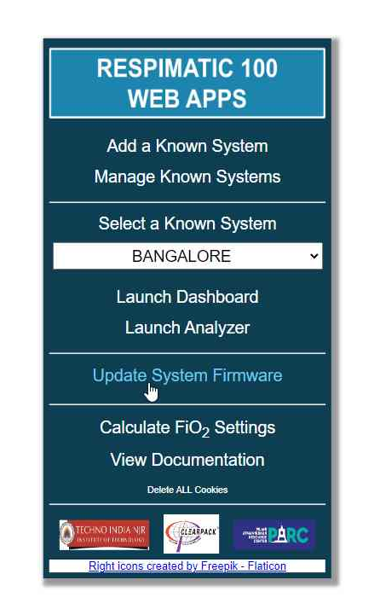
Download Arduino Builder – Step 1
Open URL https://www.respimatic.com in your browser
Click on “Update System Firmware”

Slide 5
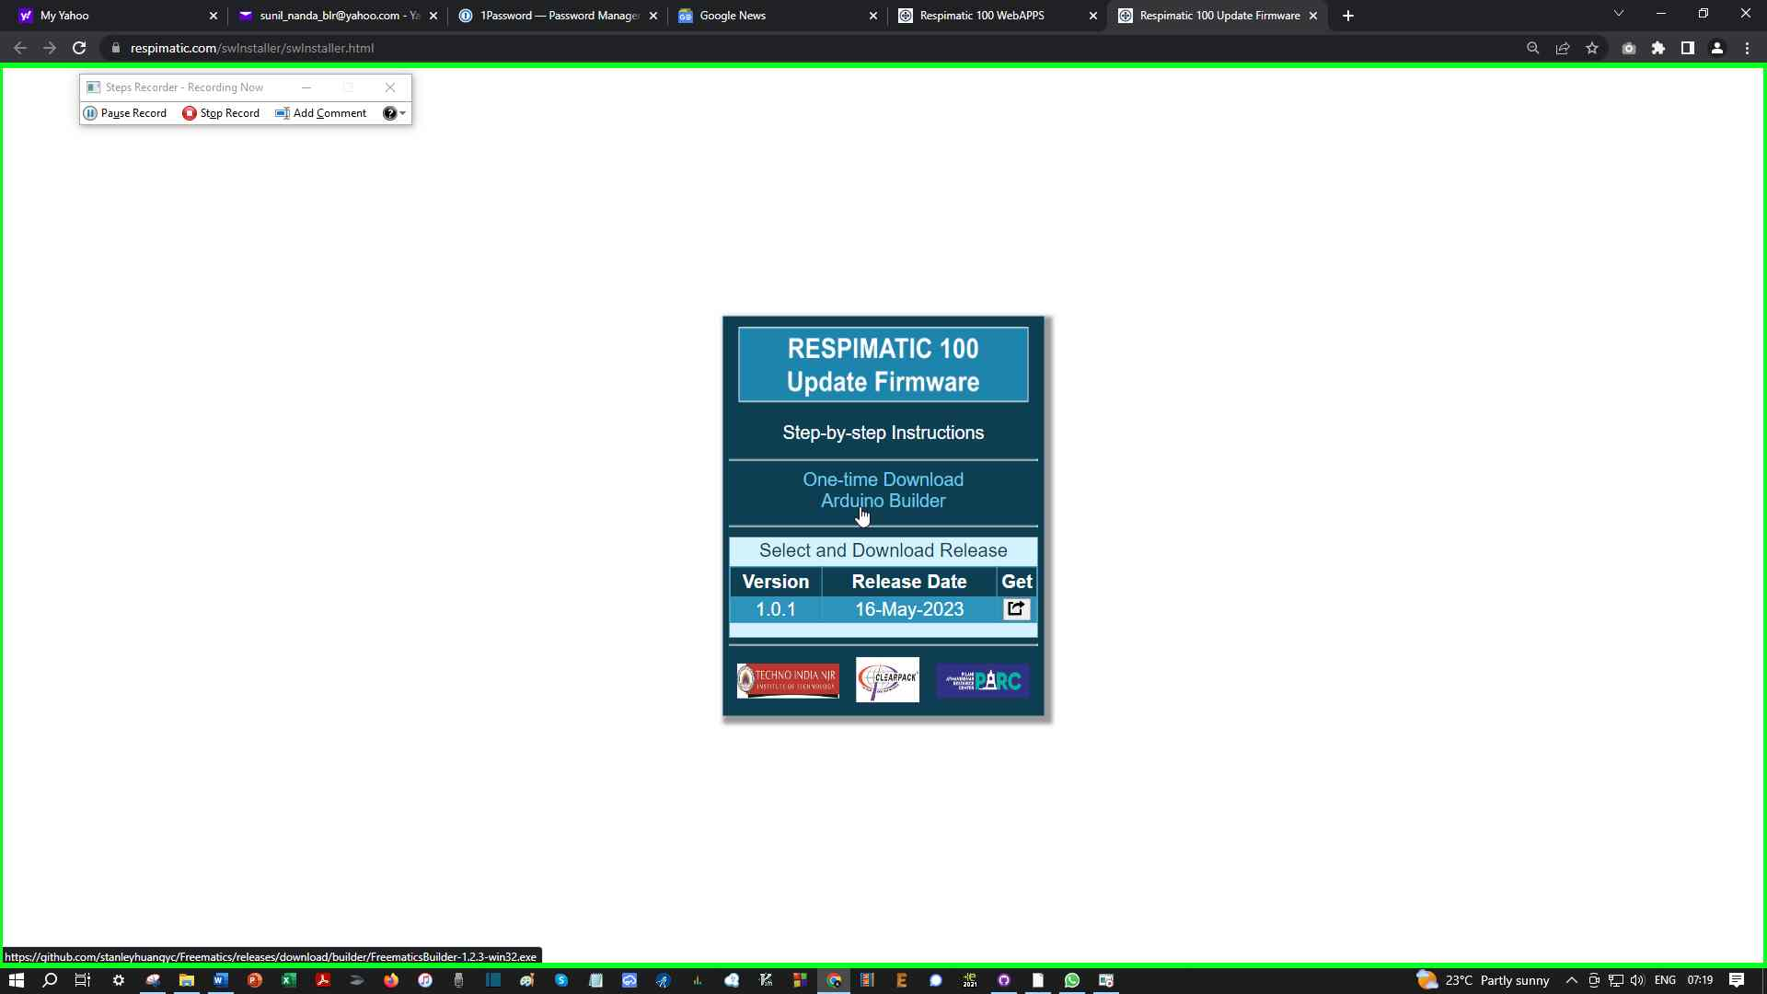
Download Arduino Builder – Step 2
Click on “On-time Download Arduino Builder”

Slide 6
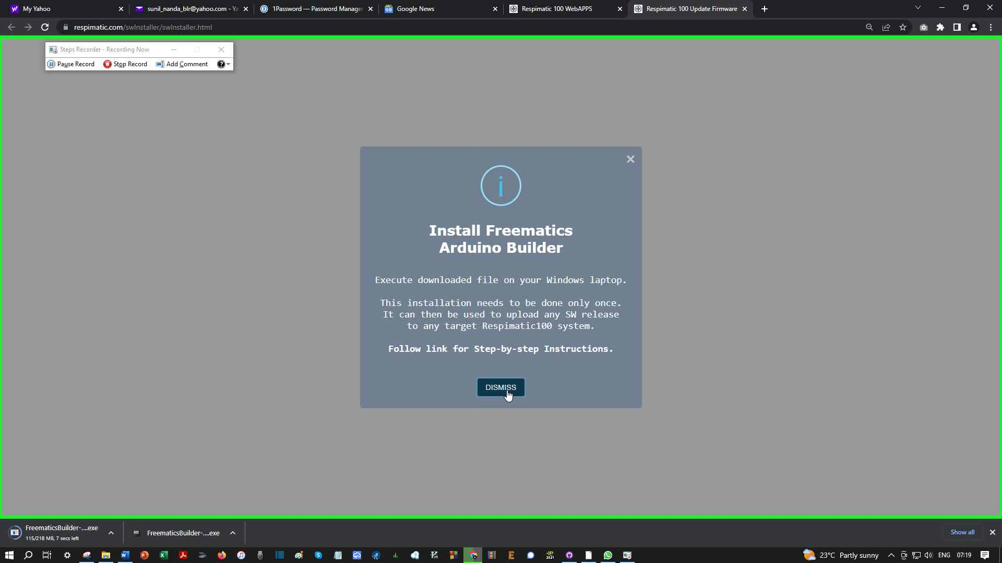
Download Arduino Builder – Step 3
The .exe is downloaded to your Downloads folder
Read and Dismiss the information popup

Slide 7
Install Arduino Builder

Slide 8
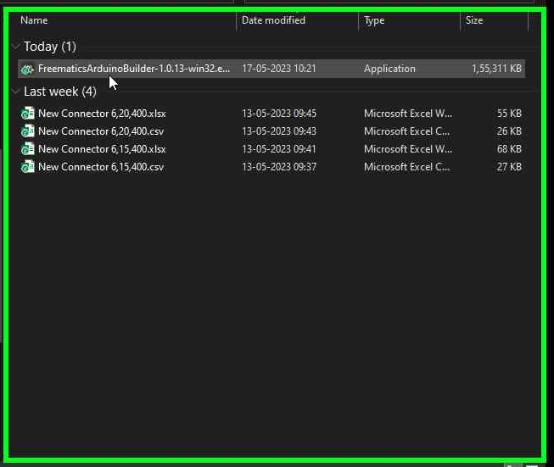
Install Arduino Builder – Step 1
Find the downloaded .exe file (in your Downloads folder)
Double Click on the .exe file to execute it
You will need admin privileges on your laptop to execute this file
Your laptop’s anti-virus software will sanitize the file automatically

Slide 9
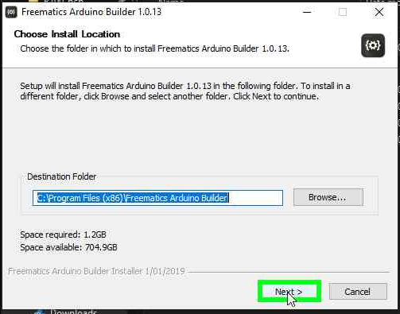
Install Arduino Builder – Step 2
The Arduino Builder installer will guide you step-by-step
Click “Next”

Slide 10
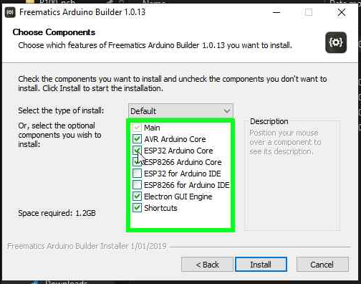
Install Arduino Builder – Step 3
Uncheck “ESP32 Arduino Core”
Click “Install”

Slide 11
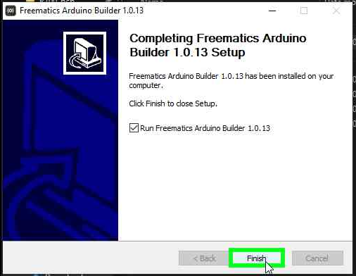
Install Arduino Builder – Step 3
Click “Finish”

Slide 12
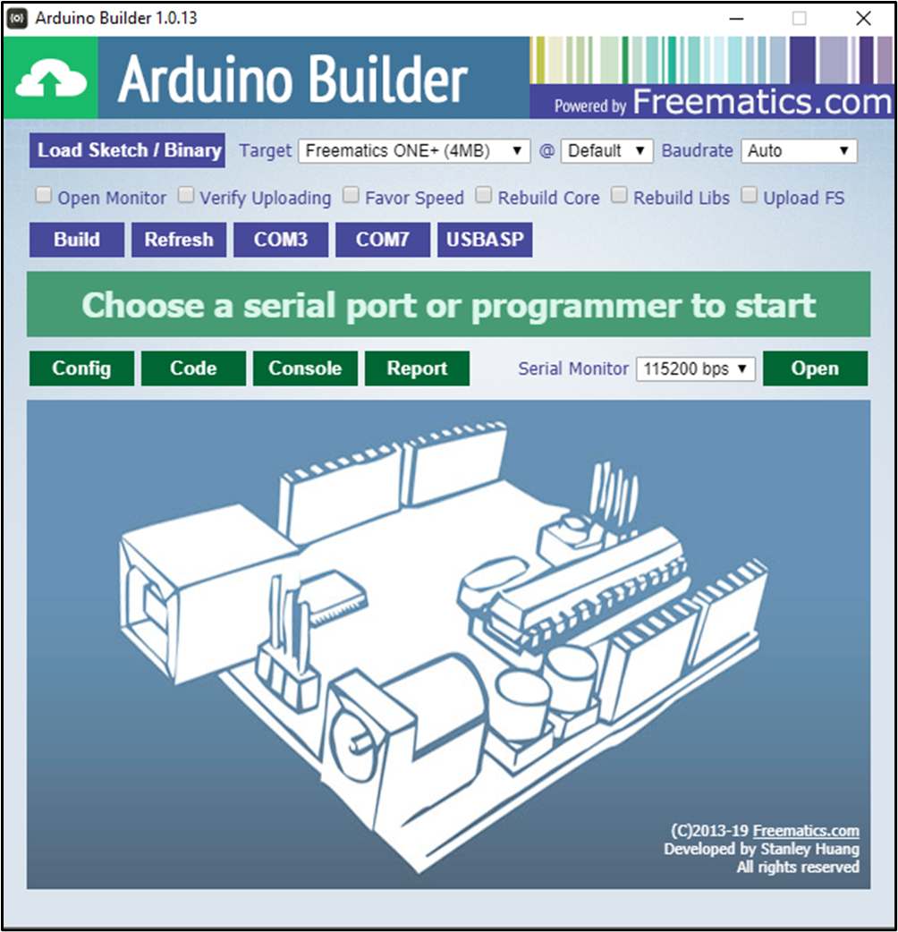
Install Arduino Builder – Step 4
Arduino Builder is installed!
You can now delete the .exe file in your Downloads folder

Slide 13
Download a Firmware Release

Slide 14
Download Firmware Release – Step 1
Open URL https://www.respimatic.com in your browser
Click on “Update System Firmware”

Slide 15
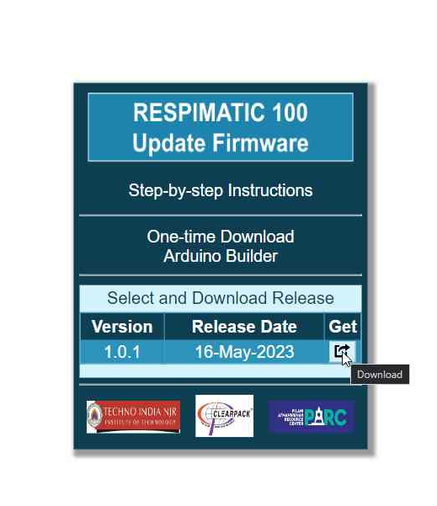
Download Firmware Release – Step 2
Click on the download icon button next to the release you wish to download

Slide 16
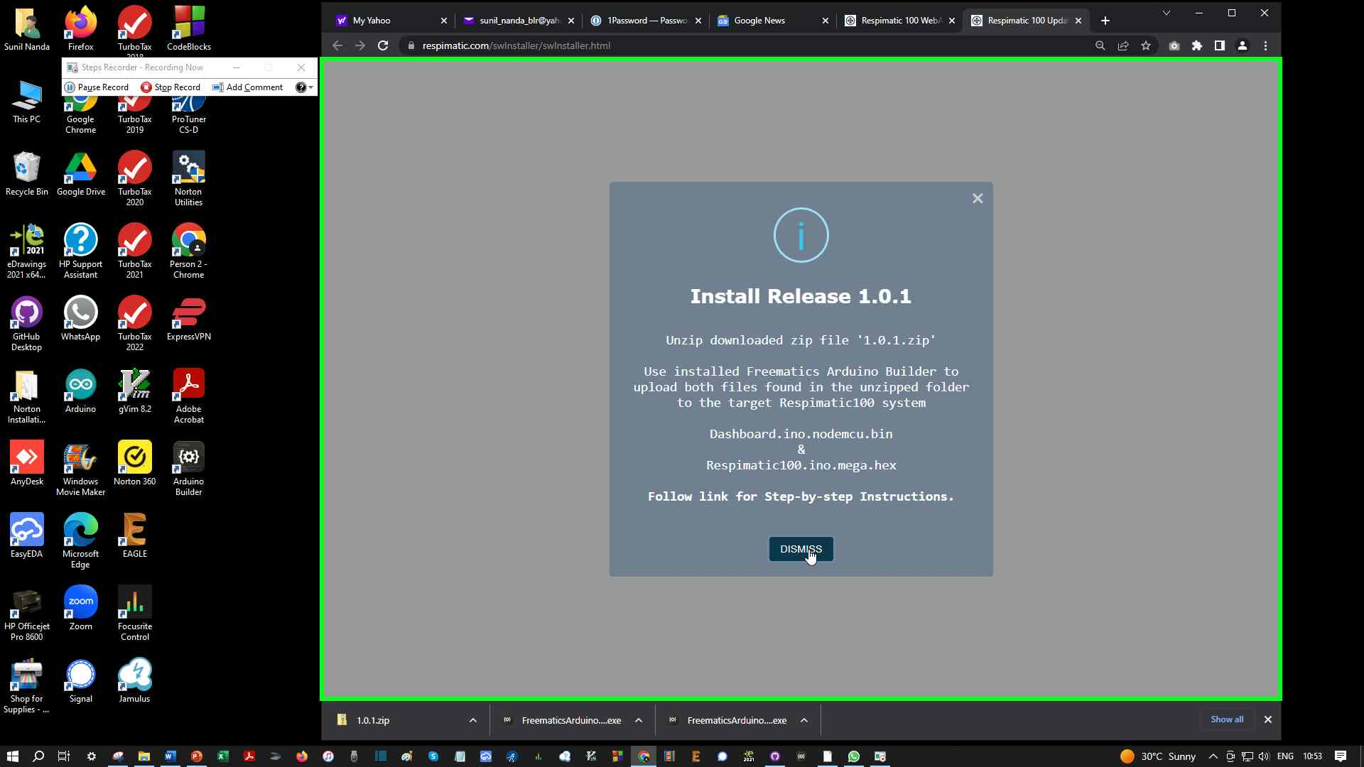
Download Firmware Release – Step 3
A .zip is downloaded to your Downloads folder
Read and Dismiss the information popup

Slide 17
Download Firmware Release – Step 4
Double click on the downloaded .zip file to open it
It should show two files within it
Dashboard.ino.nodemcu.bin
Respimatic100.ino.mega.hex
Click on the “Extract All” button

